Slide 1
PHIL-CHON
A website for all your filipino snacks and treats
By: Damien Bisa and Katrice Francisco

Slide 2
TABLE OF CONTENTS
01
02
03
04
05
06
Purpose of Website
Technologies used for Website
Website Architecture
Website Features
Features in Progress
Improvements

Slide 3
Purpose of Website
The purpose of our website was to sell authentic Filipino snacks and necessities. Our mission on this project was to present our products to the public to enjoy and try our filipino snacks; And if anyone would like to try any of our filipino culture necessities it would be right on hand to order and shipped right to their door. It was our mission on this project to make it look and feel as welcoming as possible. As from our Filipino culture, we are all kind to everyone and would love everyone to feel welcome and enjoy our website as we add and delete products to everyone's liking. Our website does not only pull in just Filipinos but everyone who would be interested in trying new things and new snacks! To us Filipino snacks are comfort food all day everyday and we would love to share that with our customers.

Slide 4
Technologies used for Website
Sublime Text
Visual Studio Code
XAMPP
PhpMyAdmin
MySQL Database
SQL
PDO
Bcrypt
HTML
CSS
PHP
Bootstrap

Slide 5
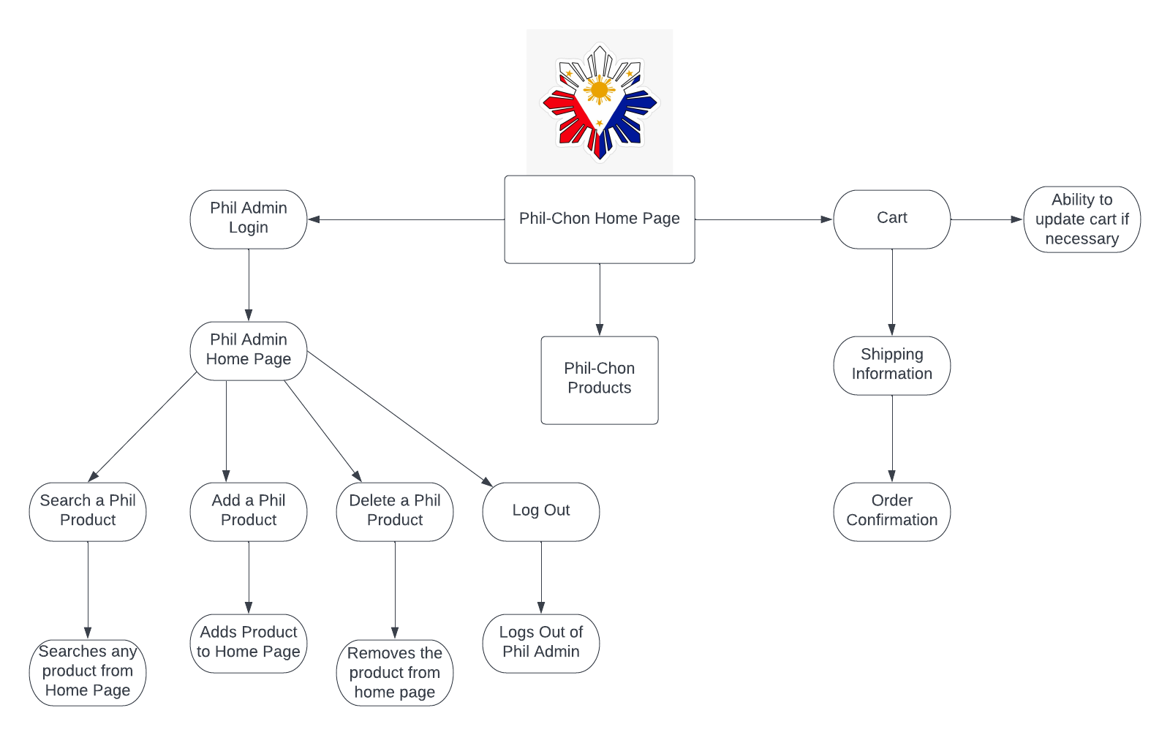
Website Architecture

Slide 6
Website Features
A Product Page/Homepage (Users can see available products and purchase them)
A Cart/Checkout Page (Users may check their added products and purchase them)
An Admin Page (This is a restricted access page where administrators for the website will be able to add, delete, and insert products)

Slide 7
Features in Progress
User Login Page
Storing multiple user accounts in the database
Adding more Filipino products to the website

Slide 8
Improvements
Add more user friendly graphics to the website (ex. cartoons and characters)
Implement a payment method at checkout (ex. Paypal or Afterpay function)
Have a edit button to edit products instead of only insert and delete function

Slide 9
SALAMAT!
Means Thank You in Tagalog/Filipino
We hope you enjoy our website!

